Slide 1
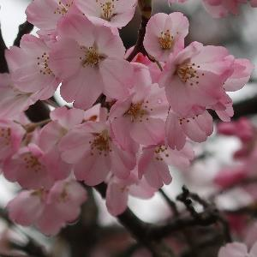
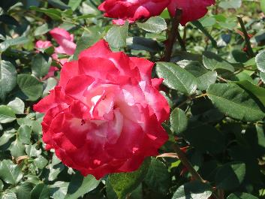
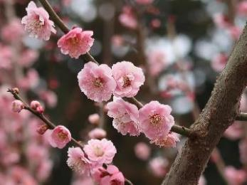
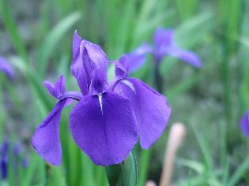
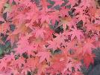
Japanese flowers and trees

Slide 2
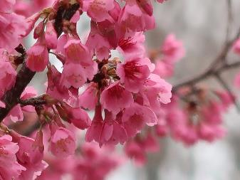
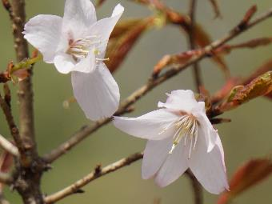
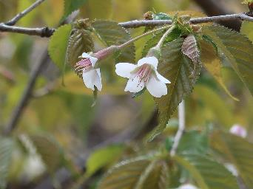
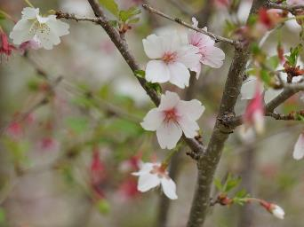
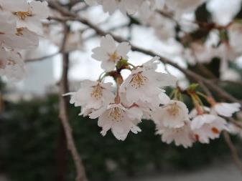
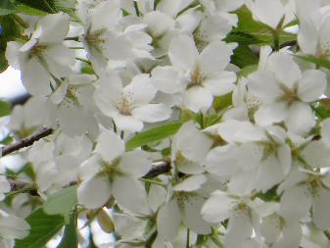
Japanese wild cherry(species cherry)
KANHIZAKURA 寒緋桜
Taiwan cherry/ Cerasus campanulate
February to Early March
KUMANOZAKURA 熊野桜
Kumano cherry/Cerasus kumanoensis
Mid march
CYOJIZAKURA 丁字桜
Clove cherry/ Cerasus apetala
Mid March to Late March
MAMEZAKURA 豆桜
Fuji cherry/ Cerasus incisa
Mid March to Late March
EDO-HIGAN 江戸彼岸
Cerasus spachiana f. ascendens
Mid March to Late March
OSHIMA-ZAKURA 大島桜
Oshima/ Cerasus speciosa
Late March to Early April

Slide 3
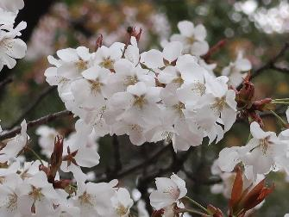
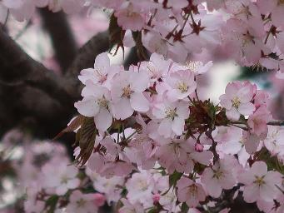
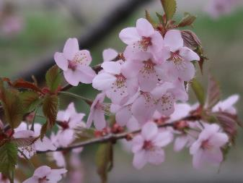
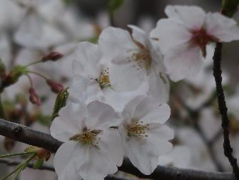
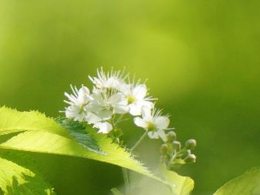
Japanese wild cherry(species cherry)
YAMAZAKURA 山桜 Japanese mountain cherry, Cerasus jamasakura
Late March to Early April
OYAMAZAKURA 大山桜 Sargent’s cherry/ Cerasus sargentii
Late March to Early April
CHISHIMAZAKURA 千島桜
Kurile cherry/ Cerasus nipponica
Early April to Mid April
カスミザクラ 霞桜
Kasumizakura/ Cerasus leveilleana
Early April to Mid April
MIYAMAZAKURA 深山桜
Miyama cherry/ Cerasus maximowiczii
Mid April to late April

Slide 4
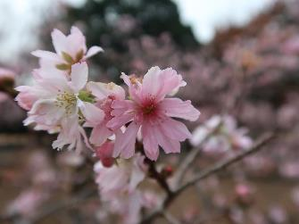
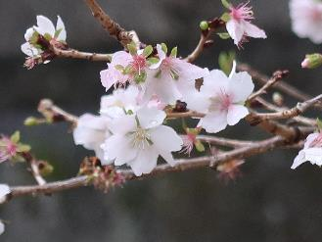
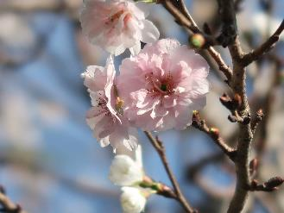
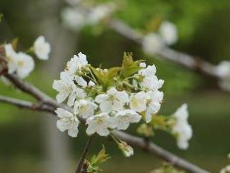
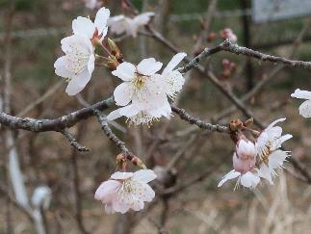
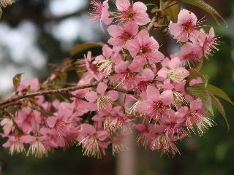
Autumn/Winter cherry
JUGATSUZAKURA 十月桜
October sakura/
Cerasus subhirtella
FUYUZAKURA 冬桜
Winter cherry
Cerasus x parvifolia
KOBUKUZAKURA 子福桜
Kobuku zakura
Prunus x Kobuku-zakura
Foreign cherry
SEIYOUMIZAKURA 西洋実桜
Sweet cherry/ Cerasus avium
KARAMIZAKURA 唐実桜
Chinese sour cherry/Cerasus pseudo-cerasus
Wild Himalayan cherry
Cerasus cerasoides

Slide 5
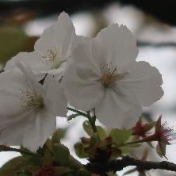
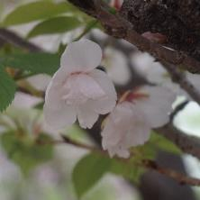
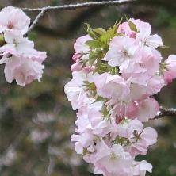
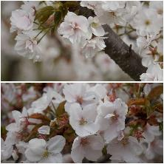
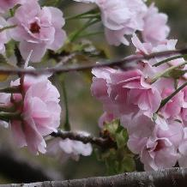
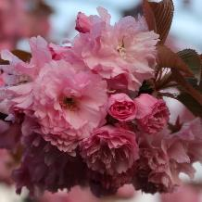
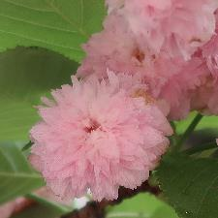
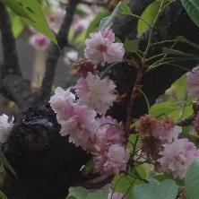
Shape of Flower（花の形）
TAIHAKU 太白
Single petal/一重
HOTATE 帆立Single+Flag/一重+旗弁
MIKURUMAKAESI 御車返Single-double/一重八重
OMURO-ARIAKE 御室有明Single-double/一重八重
SASABE 笹部
Semi-double/半八重
KANZAN 関山
Double/八重
KENROKUEN-KIKU 兼六園菊double of narrow petal/菊咲
NIDOZAKURA 二度桜
Two steps/二段咲

Slide 6
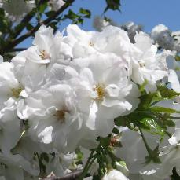
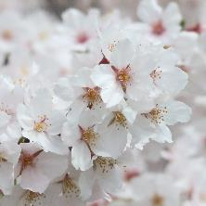
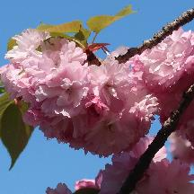
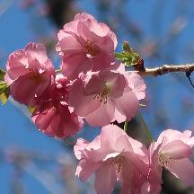
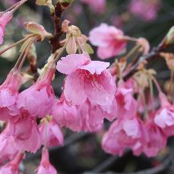
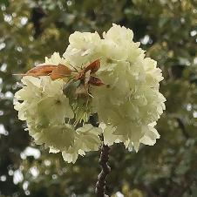
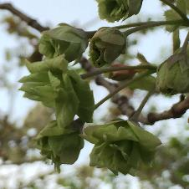
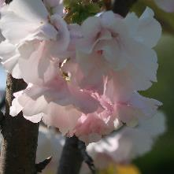
Color of Flower（花の色）
SHIROTAE 白妙
White/白
SOMEIYOSHINO 染井吉野Pale pink/淡桃
KOUKA 紅華
Pink/紅色
BENIYUTAKA 紅豊
Dark pink/濃紅色
RYUKYUHIKAN 琉球緋寒
Purple red/紫紅
UKON鬱金
Yellow green/黄緑
GYOIKOU 御衣黄
Green/緑
YAEAKEBONO 八重曙
Mixed/複色

Slide 7
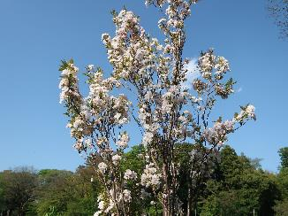
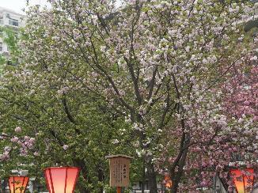
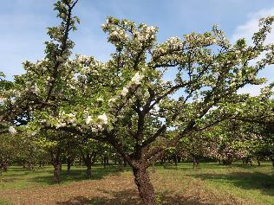
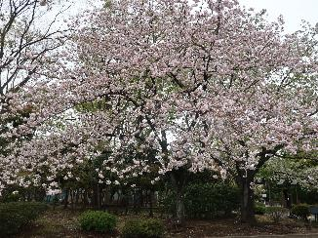
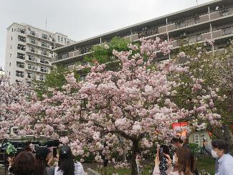
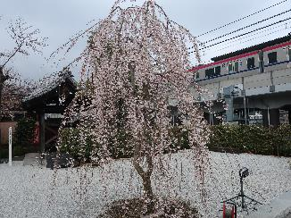
Shape of tree（樹の形）
AMANOGAWA 天の川
Cylindrical /円柱状
TAIZANBUKUN 泰山府君
Broom-shaped/箒状
ICHIHARA-TORANO市原虎の尾Cup-shaped /盃状
ICHIYO 一葉
Broad-oval/広卵状
SYOGETSU 松月
Umbrella-shaped /傘状
SHIDARE 枝垂（江戸彼岸）Weeping /枝垂

Slide 8
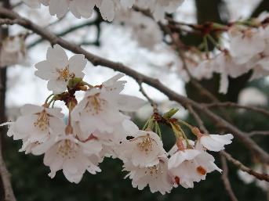
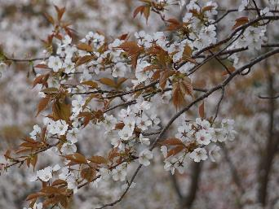
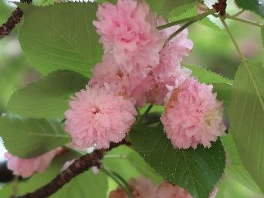
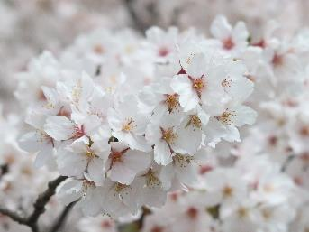
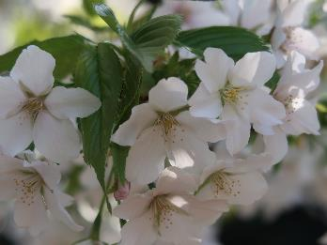
Blooming with leaf 開花と葉の出現
Before leaf 葉より先
With leaf 葉と同時
After leaf 葉より後
EDO-HIGAN 江戸彼岸
YAMAZAKURA 山桜
KENROKUEN-KIKU 兼六園菊
SOMEIYOSHINO 染井吉野
OSHIMA-ZAKURA 大島桜
MIYAMAZAKURA 深山桜

Slide 9
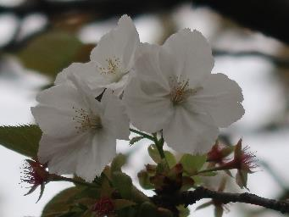
Size of flower 花の大きさ
Small 小輪
Middle 中輪
Large 大輪
MAMEZAKURA 豆桜
SOMEIYOSHINO 染井吉野
TAIHAKU 太白
OKAME オカメ
KOMATSU OTOME 小松乙女
KANZAN 関山

Slide 10
Size of Tree 樹高
Small 低木
Middle 中木
High 高木
MAMEZAKURA 豆桜
TOKAI 東海
SOEMIYOSHINO 染井吉野
OKAME オカメ
OMUROARIAKE 御室有明
MAIHIME 舞姫

Slide 11
Lines of Someiyoshino 染井吉野の系統
Parents 親系統
Sisters 兄弟系統
Descendants 子系統
EDO-HIGAN 江戸彼岸
SOMEIYOSHINO 染井吉野
JINDAI AKEBONO 神代曙
OSHIMA-ZAKURA 大島桜
KOMATSU OTOME 小松乙女
SYOWA ZAKURA 昭和桜

Slide 12
桜の名所・銘木
Mt.Yoshino 吉野山

Slide 13
Three famous stand alone cherry日本三大桜
YAMATAKA JINDAI 山高神代

Slide 14
Three famous stand alone cherry日本三大桜
NEO USUZUMI 根尾薄墨

Slide 15
Three famous stand alone cherry日本三大桜
MIHARU TAKIZAKURA 三春滝桜

Slide 16
NINNAJI TEMPLE 仁和寺

Slide 17
TAKATO CASTLE RUINS 高遠城址

Slide 18
OSAKA MINT BUREAU 大阪造幣局

Slide 19
UENO PARK 上野公園

Slide 20
UME（梅）
Japanese apricot
MOMO（桃）
Peach
SAKURA（桜）
Cherry

Slide 21
Japanese name | UME（梅） | MOMO（桃） | SAKURA（桜）
Botanical name | Prunus mume | Prunus persica (Amygdalus persica) | Cerasus (× yedoensis) Prunus (× yedoensis)
English name | Japanese apricot | Peach | Cherry
Petal | Round | Oblong to sharp points | Split-tipped/ heart shapes
Stalk/Bud No. | No/ One per bud | Short/ Two per bud | Long/ Many
Flower Season | February/March | March/ April | March/ April

Slide 22
Apple（リンゴ）
Malus domestica
Pear（ナシ）
Pyrus pyrifolia
Almond（アーモンド）
Prunus dulcis

Slide 23
Three Group of Roses
Common name | Modern garden Rose (“La France”) | Old garden roses (“Rose de Mai”) | Wild Roses (Species Roses) (“Dog rose”)
Botanical name | Rosa x La France | Rosa x Rose de Mai | Rosa canina
Flower Season | Usually continuous blooming | Mainly one blooming, some continuous blooming | Mainly one blooming, some repeat/continuous blooming
Brief Description | After created 'La France', in 1867, garden roses created from wide varieties of genotype are usually called modern garden roses. | Garden roses mainly created before 1867 by crossing some different wild roses (mainly simple combination). | Wild or native roses from wide range of northern hemisphere but not in south. Cultivated variety after natural or artificial crossing in same species are called cultivated wild roses.

Slide 24
Garden Roses
 | Rosa x Damascene Damask Rose (Old) R. gallica/R. moschata Double pink medium, once (sometime autumn again), strong fragrance called Damask |  | Rosa x Schneewittchen, (Iceberg) Floribunda (hybrid teas/ polyantha =R.chinensis/R. multiflora), (Modern),Semi double white large, continuous flowering, hall of fame
 | Rosa x Duchesse de Brabant Tea(R. gigantea/R. chinensis) (Old), Double pink with yellow large, continuous flowering, strong tea fragrance |  | Rosa x Queen Elizabeth Grandiflora (Hybrid tea/ Floribunda) (Modern) Double pink very large, continuous flowering, hall of fame
 | Rosa x Sally Holmes Hybrid musk(R. multiflora/ R. moschata) (Old) Single white or near white large, continuous flowering, hall of fame |  | Rosa x Graham Thomas English Roses (Old roses/Hybrid tea / Floribunda) (Modern) Double yellow large, continuous flowering, hall of fame
 | Rosa x Peace Hybrid tea (Hybrid perpetuals/ Tea), (Modern) Double yellow with pink large, continuous flowering, hall of fame |  | Rosa x Olympic torch （聖火） Hybrid tea (Hybrid perpetuals/ Tea) (Modern） Double red with white large, continuous flowering, Bred by SUZUKI Syozou, Keisei Rose Nurseries

Slide 25
Wild (species) Roses
 | Rosa gallica/ Gallic rose Central Europe, Single pink large, once, established basic cultivar in Europe, fragrant deep pink flowers |  | Rosa gigantea Foothills of the Himalaya, Single white large, once, Large plant size, beautiful shape of petal and flavor of milk tea
 | Rosa moschata/ Musk Rose West Asia, Single white medium, repeat blooming, musky scent |  | Rosa multiflora/ Multiflora rose （野茨） Japan, Single white or pale pink small, once, multi flowers
 | Rosa nutkana/ Nootka Rose Canada, Single pink medium, once, strong fragrance |  | Rosa banksiae/ Lady Banks’ rose （木香薔薇） China, Double cream yellow/white small, once, thornless planted as garden rose
 | Rosa chinensis var. chinensis/ Chinese Rose （庚申薔薇）China, Semi double pink medium, continuous blooming |  | Rosa rugosa/ Rugosa rose （浜茄子） Japan, China, Single, red purple/ white large, repeat blooming, cold tolerance

Slide 26
Blood-red iris
AYAME（文目）
Iris sanguinea
Blue and white-yellow mesh pattern (Ayame) at base of blue purple petal
Dry land
Mid to late May
Rabit-ear iris
KAKITSUBATA（杜若）
Iris laevigata
White center stripe in blue petal or yellow stripe in white flower
Under shallow water
Mid May
Japanese Water Iris
HANA SHOBU（花菖蒲）
Iris ensata var. ensata
Yellow spot at base of petal, Colors varied from white, yellow, purple, blue purple
Shallow water or shore of water
Late May to late June

Slide 27
Japanese name | YURI （百合） | ZENTEIKA（禅庭花）,KANZOU（萱草）, KISUGE（黄萓） | INDO HAMAYU（印度浜木綿）
Botanical name | Lilium (longiflorum) | Hemerocallis (dumortieri) | Crinum latifolium
English name | Lily (Easter lily) | Daylily | Hardy swamplily
Stem and leaf | Long stem with leaves | Medium thin stem without leaf, narrow leaf from bottom | Long thick stem without leaf, wide width leaf from bottom
Pistil/ Stamen | Straight style and filament | Upward style and filament | Long upward style and curled anther
Flower Season | June to August | May to August | June to July

Slide 28
Japanese name | SAZANKA（山茶花） | TSUBAKI（椿） | CHYA（茶）
Botanical name | Camellia sasanqua | Camellia japonica | Camellia sinensis
English name | Sasanqua camellia, Christmas camellia | Japanese camellia, Camellia | Tea
Flower/Petal | Open widely/ Fallen separately | Tight closely, cup shape/ Fallen as whole | Small White slightly open/ Not fallen
Stamen/Filament | Open | Tight closely/invisible | Slightly open
Flower Season | Late autumn to mid winter | Mid Winter to Early spring | Late autumn

Slide 29
Chinese tree peony,
Tree peony
BOTAN（牡丹）
Paeonia suffruticosa
Widespread,
on the top of branch
Woody stems
April to May
Chinese peony,
Garden peony
SYAKUYAKU（芍薬）
Paeonia lactiflora
Upward,
on the top of stem
Herbaceous (no wood)
May to June

Slide 30
Seven herbs of autumn
Bush clover
Japanese arrowroot
Patrinia
Balloon flower
Susuki grass
Pink dianthus
Thoroughwort

Slide 31
Red spider lily
Lycoris radiata

Slide 32
Rhododendron/
Azalea
Tsutsuji
つつじ
躑躅

Slide 33
Sericulture

Slide 34
Lotus HASU

Slide 35
Lotus HASU

Slide 36
Water lily SUIREN

Slide 37
The Three Sacred Trees of Buddhism
Ashoka
Bonhi
Sal

Slide 38
Flower of Bamboo

Slide 39
Cedar (SUGI) | Cypress (HINOKI)
Cryptomeria japonica | Chamaecyparis obtuse
Red-brown bark trunk peels in vertical strips, needle-like leaf | Red-brown bark trunk, peels thin skin, scale-like leaf, Y shape white stomatal band on back leaf
Fast growing (40 yeas), height maximum 50m, | Slow growing, (5-60years), height maximum 30m
Soft, beautiful wood grain | Hard (become harder until 200years), moist and pest resistance, strong fragrance
Interior building material, Barrel, | Shrine& Palace, Pillar, Bath tub,

Slide 40
 |  | Japanese cedar（杉） Cryptomeria japonica Red-brown bark trunk peels in vertical strips, needle-like leaf |  |  | Momi fir （樅） Abies firma Broad conical crown, significantly flattened leaf
 |  | Japanese cypress (檜) Chamaecyparis obtuse Scale-like leaf, Y shape white stomatal band on back leaf |  |  | Sawara cypress （椹） Chamaecyparis pisifera Scale-like leaf, X shape white stomatal band on back leaf
 |  | Black pine （黒松） Pinus thunbergii Blown-black bark and hard needle, mainly on sea shore |  |  | Red pine （赤松） Pinus densiflora Reddish bark and soft needle, mainly inland
 |  | Dawn redwood （メタセコイア) Metasequoia glyptostroboides Red-bronze opposite leaves |  |  | Bald cypress（落羽松） Taxodium distichum Russet-red alternate leaves surrounded by cypress knees
 |  | Japanese Timber Bamboo （真竹） Phyllostachys bambusoides Two distinctive rings at the node |  |  | Moso bamboo(孟宗竹) Phyllostachys heterocycle One distinctive ring at the node

Slide 41
 |  | Bamboo-leaf oak(白樫) Quercus myrsinifolia Live oak, Evergreen oak, Hard wood, high quality charcoal(姥目樫) |  |  | Daimyo oak（柏） Quercus dentata Main tree species of deciduous broad-leaved forest
 |  | Camphor laurel(楠,樟) Cinnamomum camphora Produce camphor used for pest deterrent and preservative |  |  | Japanese beech(橅) Fagus crenata In north-east Japan grows from sea level, but in south-west only in mountain
 |  | Japanese zelkova(欅) Zelkova serrata Belongs to Ulmaceae, sometimes called as Japanese elm |  |  | Japanese elm（春楡） Ulmus davidana Obovate leaves changed into dark yellow in autumn
 |  | Japanese maple（いろは紅葉) Acer palmatum Palmately lobed with five, seven, or nine acutely pointed lobes |  |  | Painted maple(板屋楓) Acer pictum Five or seven wider lobes, produce small amount of suger
 |  | Sweetgum (紅葉葉楓) Liquidambar styraciflua five-pointed star-shaped leaves with hard, spiked fruits |  |  | Old world sycamore (鈴掛の木) Platanus spp. Palmate or maple-like leaf, with hanging round bell shape fruit

Slide 42
Sapindaceae ムクロジ科 Acer カエデ属
Acer palmatum イロハモミジ | Acer amoenum オオモミジ | Acer amoenum var. matsumurae
 |  | ヤマモミジ
Acer diabolicum カジカエデ | Acer pictum subsp. mono | Acer pycnanthum ハナノキ
 | イタヤカエデ

Slide 43
Sapindaceae ムクロジ科 Acer カエデ属
Acer japonicum ハウチワカエデ | Acer cissifolium ミツデカエデ | Acer maximowiczianum
 |  | メグスリノキ
Acer buergerianum トウカエデ | Acer pseudoplantanus | Acer rubrumアメリカハナノキ
 | セイヨウカジカエデ

Slide 44
Sapindaceae ムクロジ科 Acer カエデ属 Sapindusムクロジ属 Aesculusトチノキ属
Acer saccharum サトウカエデ | Acer saccharinumギンヨウカエデ | Sapindus mukorossi ムクロジ
Aesculus turbinataトチノキ | Aesculus hippocastanum
 | セイヨウトチノキ マロニエ

Slide 45
Altingiaceae フウ科 Liquidambarフウ属 Platanaceaeスズカケノキ科 Platanusスズカケノキ属
Liquidambar styraciflua | Liquidambar formosana フウ
モミジバフウ
Platanus orientalisスズカケノキ | Platanus occidentalis | Platanus × acerifolia
 | アメリカスズカケノキ | モミジバスズカケノキ

Slide 46
Celastraceae ニシキギ科 Ericaceae ツツジ科
Euonymus alatusニシキギ | Euonymus hamiltonianus マユミ
Enkianthus perulatus
ドウダンツツジ

Slide 47
Anacardiaceae ウルシ科 Euphorbiaceae トウダイクサ科
Toxicodendron succedaneum | Euphorbia pulcherrima
ハゼノキ | ポインセチア ショウジョウボク
Triadica sebifera
ナンキンハゼ

Slide 48
Fagaceaeブナ科 Fagus ブナ属 Quercus コナラ属 Magnoliaceaeモクレン科 Magnoliaモクレン属
Fagus crenata ブナ | Quercus serrata コナラ | Quercus acutissima クヌギ
Quercus myrsinifolia カシワ | Magnolia denudateハクモクレン | Magnolia obovate ホオノキ

Slide 49
Salicaceaeヤナギ科 Idesiaイイギリ属 Ulmaceae ニレ科 Ulmus ニレ属 Zelkovaケヤキ属
Idesia polycarpaイイギリ | Populus nigra var. italica | Ulmus davidana var. japonica
 | イタリアヤマナラシ(ポプラ) | ハルニレ
Zelkova serrata ケヤキ |  | Ginkgo biloba イチョウ

